Slide 1
Force, Motion & Simple Machines

Slide 2
What is Energy?
Potential Energy = Energy that is waiting
Kinetic Energy = Energy in motion

Slide 3
What is Force and Motion?
Force = Any push or pull on an object
Inertia = An object in motion will stay in motion
unless another force is applied to it
Friction = A force that acts against moving objects rubbing against them to slow them down
Newton = A measure of force
Gravity = Another force that acts against moving objects pulling them toward the earth

Slide 4
What is a Simple Machine?
Simple Machine = a tool that makes a job easier

Slide 5
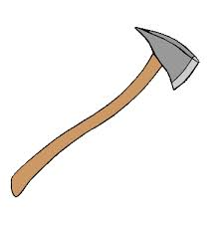
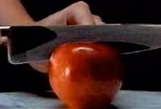
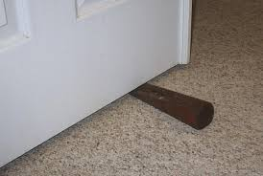
What is a Wedge?
Wedge = a piece of wood, metal, or some other material having one thick end and tapering to a thin edge, that is driven between two objects or parts of an object to secure or separate them.

Slide 6
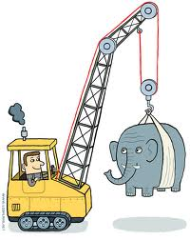
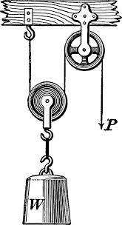
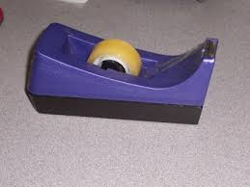
What is a Pulley?
Pulley = a wheel on an axle that is designed to support movement of a cable or belt along its circumference.

Slide 7
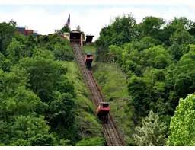
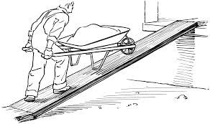
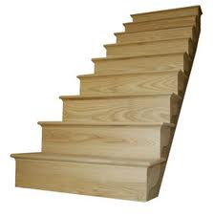
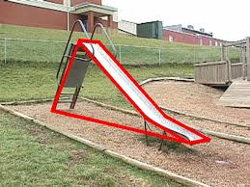
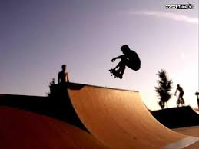
What is an Inclined Plane?
An inclined plane is a flat supporting surface tilted at an angle, with one end higher than the other, used as an aid for raising or lowering a load

Slide 8
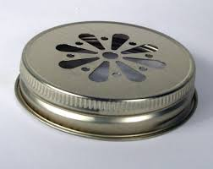
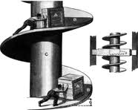
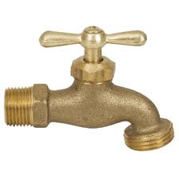
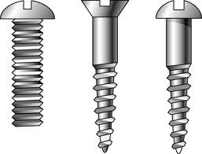
What is a Screw?
A screw is a mechanism that converts rotational motion to linear motion, and a torque to a linear force.

Slide 9
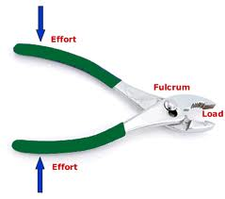
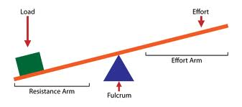
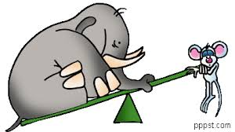
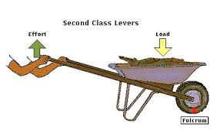
What is a Lever?
Lever = a bar that is free to turn about a fixed point.

Slide 10
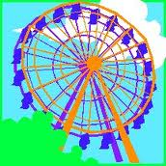
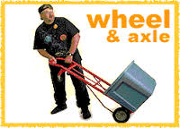
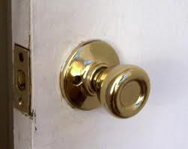
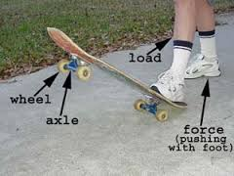
What is a Wheel & Axle?
Wheel and Axle = a simple machine consisting, in its typical form, of a cylindrical drum to which a wheel concentric with the drum is firmly fastened: ropes are so applied that as one unwinds from the wheel, another rope is wound on to the drum.

